Slide 1



Azure websites Hackaton
Alexey Bokov
Microsoft Azure evangelist for Central and Eastern Europe
Senior Program Manager, TED team, Corp DX
abokov@microsoft.com
abokov

Slide 2
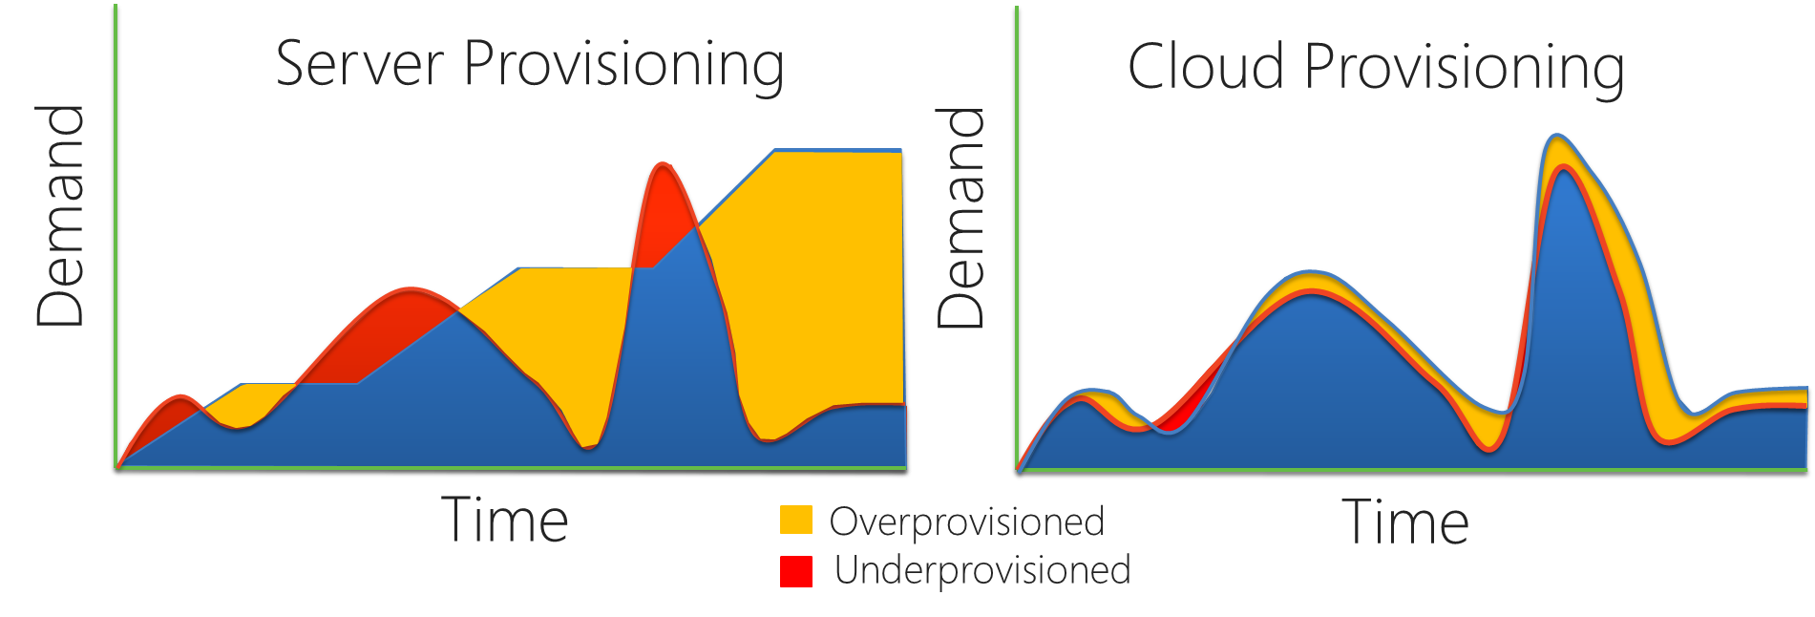
What is a “Cloud”?
Cloud: on-demand, scalable, multi-tenant, self-service compute and storage resources

Slide 3
Why Architect for the cloud?

Slide 4
Microsoft Azure Global Presence 16 Regions and growing
Azure footprint

Slide 5
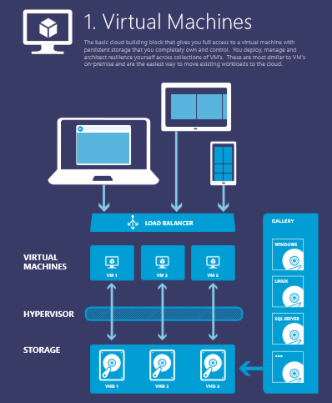
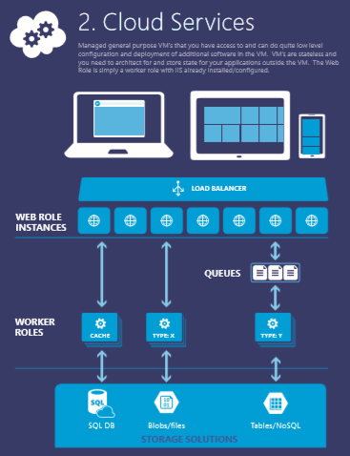
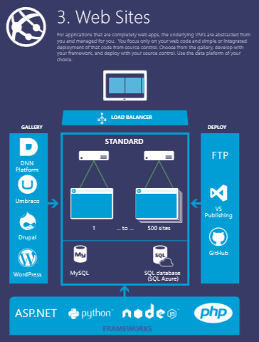
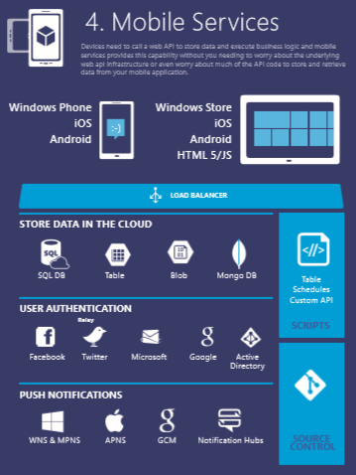
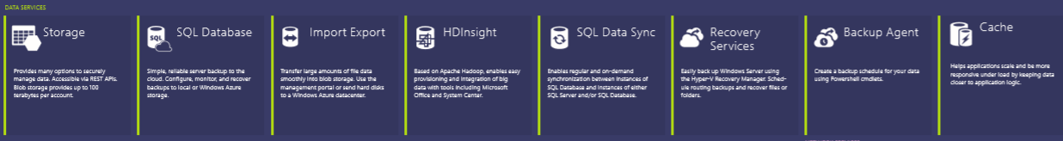




Notes:
You can use this to explain all the Azure building blocks – the compute services at the top and then the other blocks of services – data, networking, Apps…. OR you can go with the next set of slides… YOUR CHOICE…

Slide 6
>375k
Azure Websites by the Numbers
>2Billion
Websites Hosted
Requests per Day
>200k
Unique
Customers
500
650
%
%
120
Yearly Traffic
Growth
Yearly Revenue
Growth
% Yearly Paid Subscription Growth

Slide 7

























Azure Websites Customers and Partners Folks doing interesting things on the platform
Notes:
Customers are enterprises (mostly .com) agencies, Microsoft. A lot of traction on CMS and WP.
Car companies do digital marketing campaigns, MSFT does blogs.
Airlines are using the platform to reach customer and host critical application.
Digital agencies (like Hogarth) are using Websites as a core platform on which they built solutions
MSIT looking at using Hybrid Connections for business apps. Good traction with Nordstrom on e-commerce

Slide 8







Who uses Azure Websites?

Slide 9
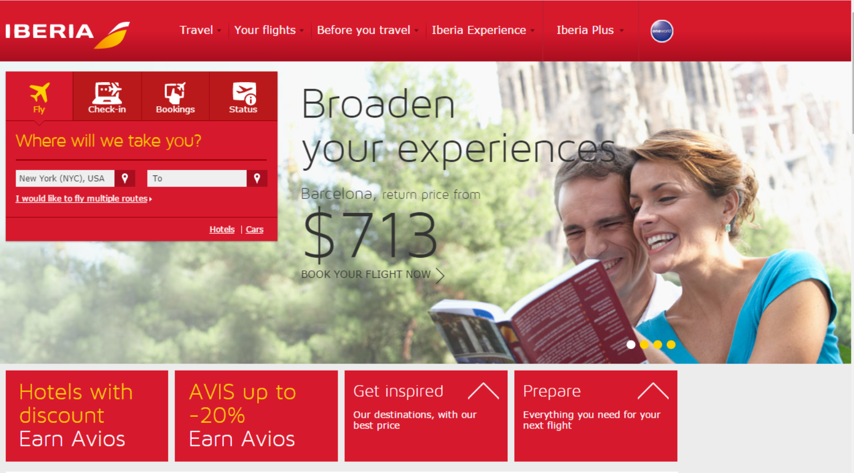
Objectives
Scalable e-commerce website to sell flights, both through travel agencies and directly to consumers
Tactics
Built Azure -based website using Umbraco and SQL on Azure for content and images.
Using VNET connecting on-premise
Results
Scalable Website with integration for Flight booking and Check In systems
Notes:
Timing: 2 minutes
Purpose: Share stories of customers that are reimagining their business using Microsoft technology. Select the stories that will resonate best with your customer. Additional customer case studies and references may be found at http://erdesk.
Key Points:
Customer Profile: Emirates is an international airline based in Dubai, United Arab Emirates. It operates more than 2,500 flights per week to 126 cities in 74 countries across six continents.
Business goal:
Tactics:
Results:
Additional Information: workingon case study

Slide 10
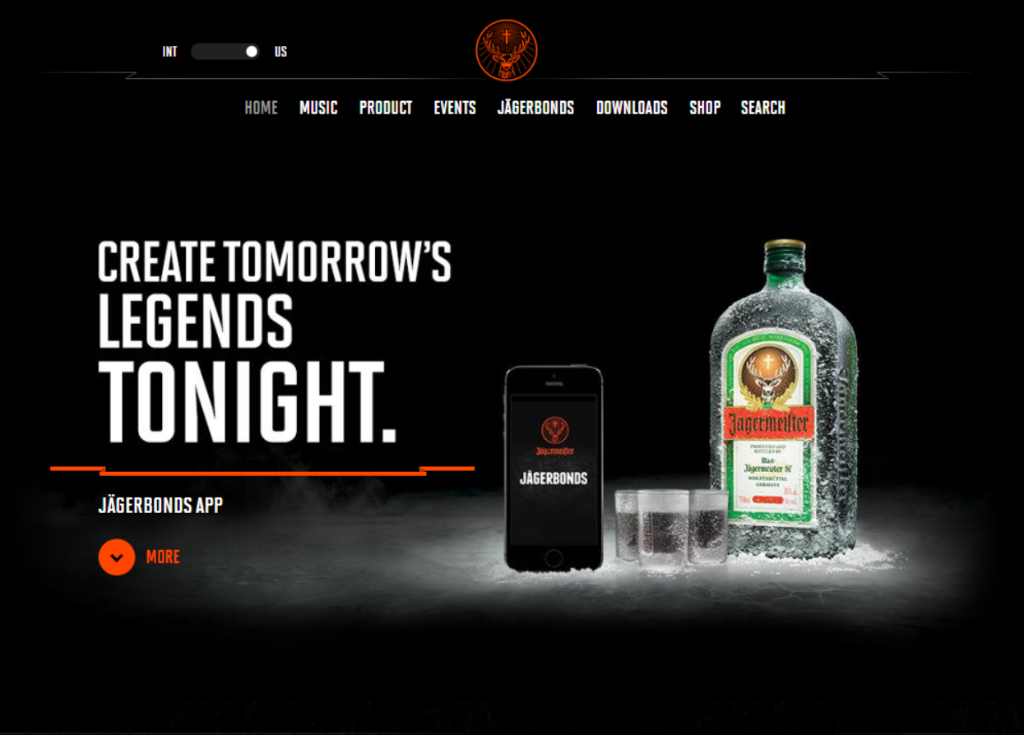
Jägermeister
Objectives
Create brand awareness and loyalty
Understand tastes and preferences of audience
Connect consumer through shared experiences
Tactics
Cloud-based website and mobile application for engaging customers through social media. video and audio features.
Results
Mobile app and Website JagerBonds allows posting photos and videos to Facebook or Instagram
Compile posts and pair them with songs
Notes:
Purpose: Share stories of customers that are reimagining their business using Microsoft technology. Select the stories that will resonate best with your customer. Additional customer case studies and references may be found at http://erdesk.
Key Points:
Customer Profile: Jägermeister is a German liqueur that is very popular with younger drinkers, and their website is squarely targeted at this demographic
Business goal: Enabling consumers with the ability to capture your legendary night out with friends through JägerBonds. From first shot to last call, the pictures, videos and posts everyone shares are turned into an epic music video.
Tactics: Both the website and the app run on Azure.
Results: The app gives customers a reason to use the app again and again, driving brand awareness and loyalty – by associating the brand with a great time out.

Slide 11
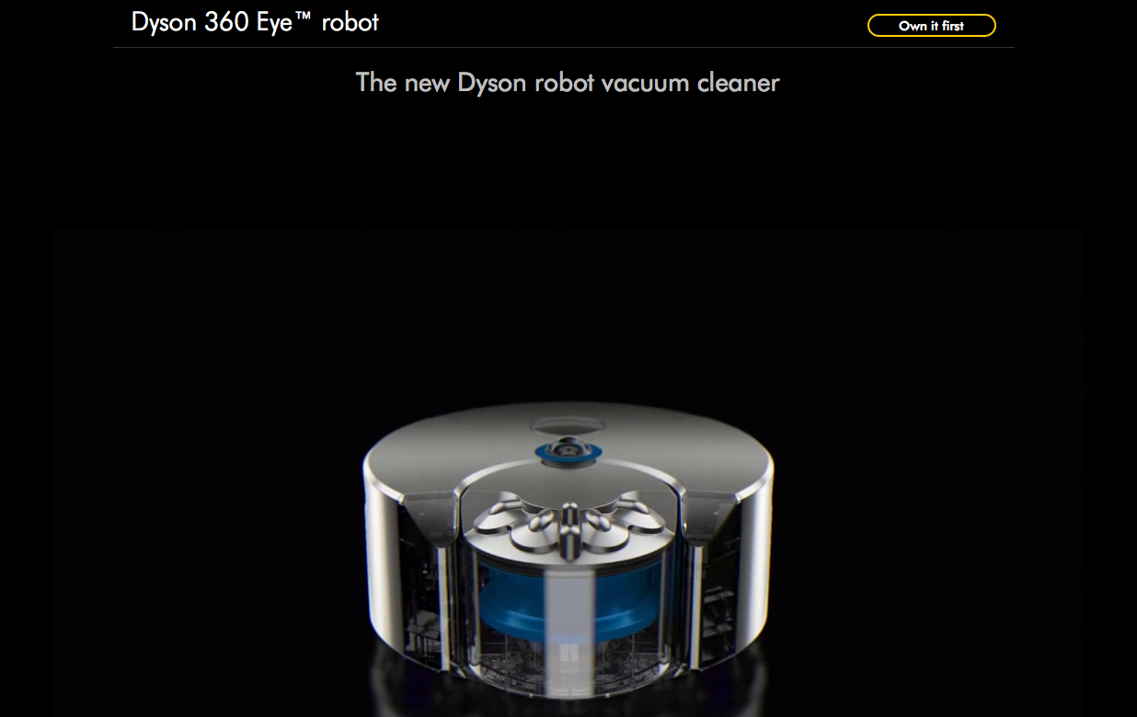

Hogarth - Digital Marketing Platform
Objectives
Hogarth wanted to streamline the development and management of its clients websites.
Tactics
Hogarth developed an innovative Digital Web platform on Azure Websites
Results
Dramatically reduces website launch times.
Scales to meet demand—no matter how high.
Provides the ability to localize and update sites quickly and easily.
Notes:
https://customers.microsoft.com/Pages/CustomerStory.aspx?recid=16778
Dyson’s largest product launch in 15 years
Expected 150k hits/day
2.5m users within 48hrs!
Global demand – compared with forecast of Japanese interest only
Site scaled automagicaly to handle load
No site outages
Real-time updates performed to add new content (launch video) to capitalize on extra attention.
3.5m users as of last week

Slide 12
Azure Websites Features & Capabilities
Enterprise-class
Designed for secure mission-critical applications
Global scale
Optimized for Availability and Automatic scale
Built for DevOps
Agility through Continuous Deployment
Hybrid Connections / VPN Support
Scheduled Backup
Azure Active Directory Integration
Site Resiliency, HA, and DR
Web Jobs
Role Base Access Control
Audit / Compliance
Enterprise Migration
Client Certs
Redis Caching
IP Restrictions/ SSL
Web Sockets
SQL, MySQL, DocDB, & Mongo
Automated Deployment AutoScale
Built-in Load Balancing
WW Datacenter Coverage
End Point Monitoring & Alerts
App Gallery
DR Site Support
WildCard Support
Dedicated IP address
HTTP Compression
WebJobs
Sticky Sessions
Remote Debugging w/ Visual Studio
Site Staging Slots
Testing in Production
Continuous Integration/Deployment
Git, Visual Studio Online and GitHub
App & Site Diagnostics
OS & Framework Patching
Site Extensions Gallery
NET, PHP, Python, Node, Java
Framework Installer
Browser-based editing
Auto-Healing
Logging and Auditing
Note: Features to discuss today are in BOLD. Items with a * are to be released
Notes:
Customers are enterprises (mostly .com) agencies, Microsoft. A lot of traction on CMS and WP.
Car companies do digital marketing campaigns, MSFT does blogs.
MSIT looking at using Hybrid Connections for business apps. Good traction with Nordstrom on e-commerce

Slide 13
Site Extensions
foo.azurewebsites.net
foo.scm.azurewebsites.net
User Site
“Monaco”
WebDeploy
Upload to site
Install from gallery
“Kudu”
WebJobs
Pre-installed
Site Extensions
“Bring your own”
Site Extensions
Azure Web Site

Slide 14
I- Development and Deployment
Staged Publishing
traffic
traffic
Production
swap
Production
Staging
Developer
Developer

Slide 15
I- Development and Deployment
Testing in Production
100% production.com
Production
swap
Staging
Developer

Slide 16
I- Development and Deployment
Testing in Production
80% production.com
Production
20% production.com
swap
Staging
Developer

Slide 17
II- Debugging and Investigations
Kudu
https://<mySite>.scm.azurewebsites.net/
Authenticated
Runs in the same security context as the main site
Can access the site files and environment variables
Great for admin and debugging tools

Slide 18
III- Management and Administration
Azure Portal(s)
Visual Studio
Azure API
IIS Manager
Azure Web Site
xplat CLI
PowerShell

Slide 19
Azure Websites Features & Capabilities
Enterprise-class
Designed for secure mission-critical applications
Global scale
Optimized for Availability and Automatic scale
Built for DevOps
Agility through Continuous Deployment
Hybrid Connections / VPN Support
Scheduled Backup
Azure Active Directory Integration
Site Resiliency, HA, and DR
Web Jobs
Role Base Access Control
Audit / Compliance
Enterprise Migration
Client Certs
Redis Caching
IP Restrictions/ SSL
Web Sockets
SQL, MySQL, DocDB, & Mongo
Automated Deployment AutoScale
Built-in Load Balancing
WW Datacenter Coverage
End Point Monitoring & Alerts
App Gallery
DR Site Support
WildCard Support
Dedicated IP address
HTTP Compression
WebJobs
Sticky Sessions
Remote Debugging w/ Visual Studio
Site Staging Slots
Testing in Production
Continuous Integration/Deployment
Git, Visual Studio Online and GitHub
App & Site Diagnostics
OS & Framework Patching
Site Extensions Gallery
NET, PHP, Python, Node, Java
Framework Installer
Browser-based editing
Auto-Healing
Logging and Auditing
Note: Features to discuss today are in BOLD. Items with a * are to be released
Notes:
Customers are enterprises (mostly .com) agencies, Microsoft. A lot of traction on CMS and WP.
Car companies do digital marketing campaigns, MSFT does blogs.
MSIT looking at using Hybrid Connections for business apps. Good traction with Nordstrom on e-commerce

Slide 20
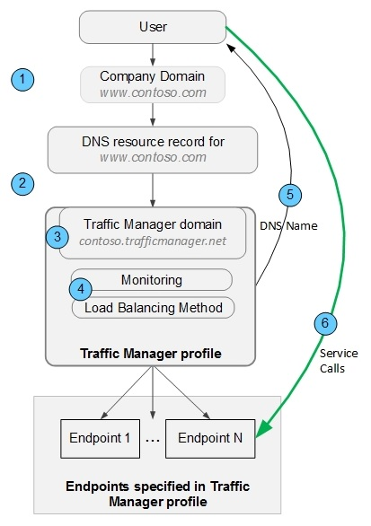
Traffic Manager – how it works ?
Notes:
1,000 new customers per day
1,000,000 cores milestone achieved September last year
1.6 Hexabyte milestones achieved at the end of last year

Slide 21

Use Azure to load
Balancing (round robin)
www.cloudtechnologies.ru
VM ( abokov.cloudapp.net )
abokov.trafficmanager.net
Mode: roundrobin
abokov-site.azurewebsites.net
( backup replica )
Notes:
1,000 new customers per day
1,000,000 cores milestone achieved September last year
1.6 Hexabyte milestones achieved at the end of last year

Slide 22

Use Azure as disaster recovery for your site
www.cloudtechnologies.ru
Linux VM ( abokov.cloudapp.net )
abokov.trafficmanager.net
Mode: Failover
Backup web-site
abokov-site.azurewebsites.net
Notes:
1,000 new customers per day
1,000,000 cores milestone achieved September last year
1.6 Hexabyte milestones achieved at the end of last year

Slide 23

Tasks for hackaton
Notes:
1,000 new customers per day
1,000,000 cores milestone achieved September last year
1.6 Hexabyte milestones achieved at the end of last year

Slide 24
Hackaton!!!!! TASK #1
Create some ‘HelloWorld’ site ( PHP or Java ) on github
Deploy on Web-sites!
Do changes in code : check production staging and development staging
Do multi-datacenter deployment!
How to do multi datacenter SQL back-end ?
Use traffic manager in different modes:
Notes:
1,000 new customers per day
1,000,000 cores milestone achieved September last year
1.6 Hexabyte milestones achieved at the end of last year

Slide 25
Questions for task #1
In round robin mode how routing works ? When we go to which end-point ( check one ip, several ips, something under proxy )
Do stress test:
Kill one website
Check is it available for end customers?
Check timelines when TrafficManager figure it out. ( check different scenarios )
Notes:
1,000 new customers per day
1,000,000 cores milestone achieved September last year
1.6 Hexabyte milestones achieved at the end of last year

Slide 26
Hackaton!!!! TASK #2
Create some ‘HelloWorld’ site with node.js on github
Do stress test : run massive requests and check answers – are we always get root page ? ( look for bug when we get 200 ok and empty body !)
Create a graph with response codes, response time depending on requests amount
Check the same stuff with autoscaling!
Notes:
1,000 new customers per day
1,000,000 cores milestone achieved September last year
1.6 Hexabyte milestones achieved at the end of last year

Slide 27
Hackaton!!!! TASK #3
Create some ‘HelloWorld’ site on github
Deploy it : one replica your hosting, another replica on Azure
Use TrafficManager for this in round robin mode and fail-over
Check response time in both modes for both replicas
Shutdown your own hosting
Check what happened
Notes:
1,000 new customers per day
1,000,000 cores milestone achieved September last year
1.6 Hexabyte milestones achieved at the end of last year

Slide 28

How to Azure : Tips and trick
30 days trials on windowsazure.com
2year trial for MSDN members
3year trial for BizSpark member ( very easy to join! ) – each BizSpark trial includes 5 MSDN subscriptions
You may try to get Windows Azure Offer $60K for 2y
25% discount to MSDN members for out-of-limit Azure usage
GREAT, BIG DISCOUNTS via Enterprise Agreement!

Slide 29

Business support, if you do app based on Azure:
We can do co-marketing
You will have technical and business persons to contact with
You may have great discounts on cloud
Early access to betas and updates
Participation in Microsoft activities – events, road-show, campaign, business and tech trainings
Yes, we have Go-To-Market program for our partners which run on a global level and we can help you to open doors in specified region/industry

Slide 30

Let’s get started !
Notes:
1,000 new customers per day
1,000,000 cores milestone achieved September last year
1.6 Hexabyte milestones achieved at the end of last year

